Slide 1
Strings
A string is a sequence of one or more characters (letters, numbers, symbols)
Strings exist within either single quotes ' or double quotes " or even triple quotes ‘ ‘ ‘
Strings are not understood by python, it is a message to the user in the user’s local language like Hindi, Marathi, Gujarati.

Slide 2
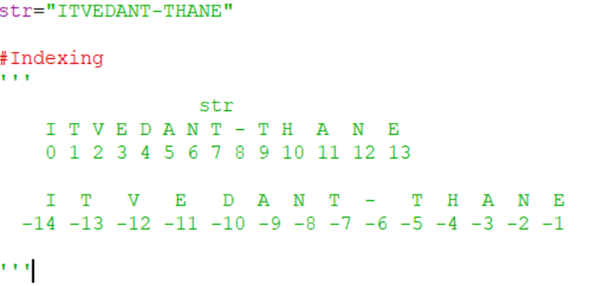

Slide 3
Slicing
You can return a range of characters by using the slice syntax.
Specify the start index and the end index, separated by a colon, to return a part of the string.
Get the characters from position 2 to position 5 (not included):
b = "Hello, World!" print(b[2:5])
Get the characters from the start to position 5 (not included):
b = "Hello, World!" print(b[:5])
Get the characters from position 2, and all the way to the end:
b = "Hello, World!" print(b[2:])

Slide 4
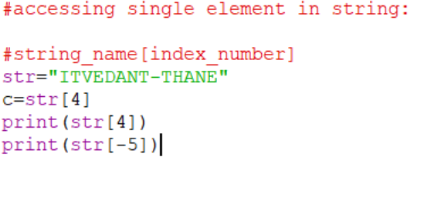
Get the characters:
From: "o" in "World!" (position -5)
To, but not included: "d" in "World!" (position -2):
b = "Hello, World!" print(b[-5:-2])

Slide 5
The upper() method returns the string in upper case:
a = "Hello, World!" print(a.upper())
The lower() method returns the string in lower case:
a = "Hello, World!" print(a.lower())
The strip() method removes any whitespace from the beginning or the end:
a = " Hello, World! " print(a.strip()) # returns "Hello, World!"
The replace() method replaces a string with another string:
a = "Hello, World!" print(a.replace("H", "J"))
The split() method splits the string into substrings if it finds instances of the separator:
a = "Hello, World!" print(a.split(",")) # returns ['Hello', ' World!']

Slide 7

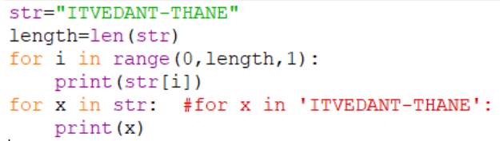

Slide 8
Check String
To check if a certain phrase or character is present in a string, we can use the keyword in.
Check if "free" is present in the following text:
txt = "The best things in life are free!" print("free" in txt)
Try it Yourself
Print only if "free" is present:
txt = "The best things in life are free!" if "free" in txt: print("Yes, 'free' is present.")
Check if "expensive" is NOT present in the following text:
txt = "The best things in life are free!" print("expensive" not in txt)

Slide 9
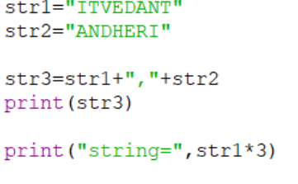
Concatenation:

Slide 10
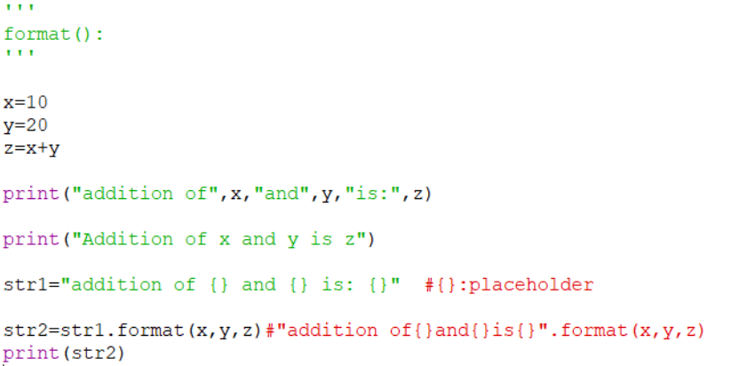
Format:
Combine strings and numbers by using the format() method!
The format() method takes the passed arguments, formats them, and places them in the string where the placeholders {} are:

Slide 11
Escape Character
To insert characters that are illegal in a string, use an escape character.
An escape character is a backslash \ followed by the character you want to insert.
An example of an illegal character is a double quote inside a string that is surrounded by double quotes:
Error : txt = "We are the so-called "Vikings" from the north.“
The escape character allows you to use double quotes when you normally would not be allowed:
txt = "We are the so-called \"Vikings\" from the north."

Slide 12
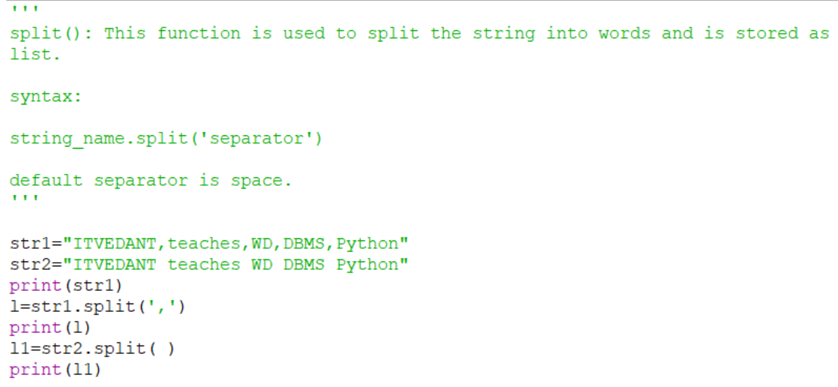
Split:

Slide 13
Lists
Lists are used to store multiple items in a single variable.
The elements of a list do not all have to be of the same data type.
A list is an ordered sequence of data.

Slide 14
Creating a list
To create a list we can directly use the square brackets and place the elements inside it.
List items are ordered, changeable, and allow duplicate values.

Slide 15
Accessing elements of a list
Lists are indexed by positive integers, starting with zero.
Use the indexing operator [ ] (square brackets) to access or update individual items of the list:
thislist = ["apple", "banana", "cherry"] print(thislist[1])

Slide 16
Using negative index
Negative indexing means start from the end
-1 refers to the last item, -2 refers to the second last item etc.
thislist = ["apple", "banana", "cherry"] print(thislist[-1])

Slide 17
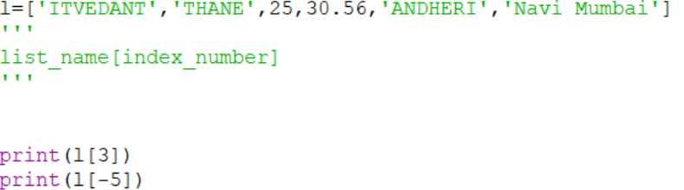

Slide 18
Using a range
Use the indexing operator [start: stop : step] we can get the sub list of the list.
If the start is not specified it defaults to 0, if the stop is unspecified it defaults to the length of the list and if step defaults to 1.
-1 refers to the last item, -2 refers to the second last item etc.
By leaving out the start value, the range will start at the first item:
Example
thislist = ["apple", "banana", "cherry", "orange", "kiwi", "melon", "mango"] print(thislist[:4])
By leaving out the end value, the range will go on to the end of the list:
thislist = ["apple", "banana", "cherry", "orange", "kiwi", "melon", "mango"] print(thislist[2:])
Specify negative indexes if you want to start the search from the end of the list:
thislist = ["apple", "banana", "cherry", "orange", "kiwi", "melon", "mango"] print(thislist[-4:-1])
The reverse of the list is thus simply possible using [::-1]

Slide 19
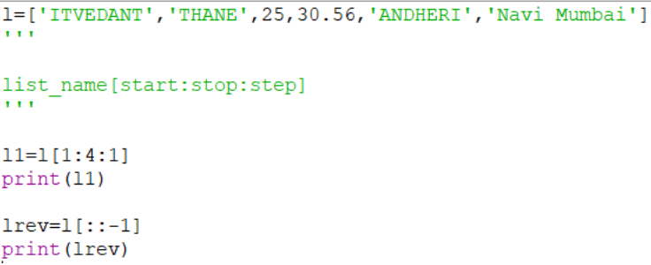

Slide 20
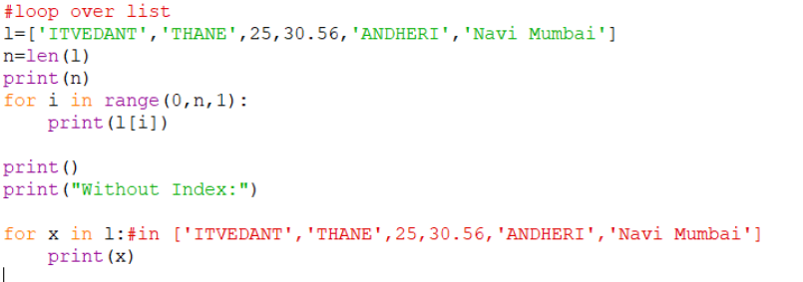
For loop in list:

Slide 21

Adding elements to a list:
To append new items to the end of a list, use the append() method:

Slide 23
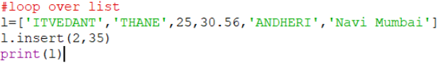
To insert an item in the middle of a list, use the insert() method:
ds.insert( 0, ‘SAS’ )

Slide 24
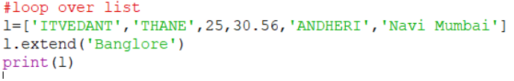
To extend a list with elements from other list use extend():
ds.extend([‘Big Data’ , ‘Deep Learning’])

Slide 25
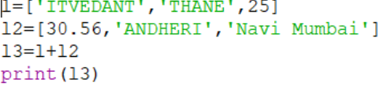
Use the plus (+) operator to concatenate lists

Slide 26
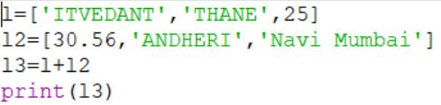

Slide 27
Sorting the list
Sorting a list with sorted() returns a new list
sort() is a method / operation on a list which sorts the list in place.

Slide 28
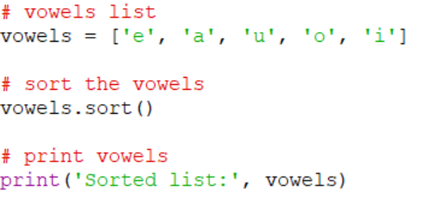

Slide 29
Reversing the list
We can reverse the list with reverse() method in-place.
We can also use the range [::-1] which returns a new reversed list.

Slide 30
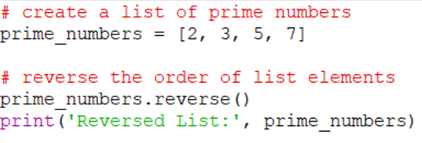

Slide 31
Copying a list
A shallow copying a list can be created with the copy() method.

Slide 32
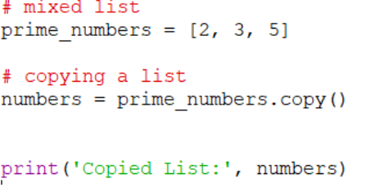

Slide 33
Remove Specified Index
The pop() method removes the specified index.
thislist = ["apple", "banana", "cherry"] thislist.pop(1) print(thislist)
If you do not specify the index, the pop() method removes the last item.
thislist = ["apple", "banana", "cherry"] thislist.pop() print(thislist)
The del keyword also removes the specified index:
thislist = ["apple", "banana", "cherry"] del thislist[0] print(thislist)
The del keyword can also delete the list completely.
thislist = ["apple", "banana", "cherry"] del thislist
The clear() method empties the list.
The list still remains, but it has no content.
thislist = ["apple", "banana", "cherry"]
thislist.clear()
print(thislist)

Slide 34
Tuple
A tuple is a frozen list i.e tuple cannot be modified once it is created.
A tuple is declared with round parentheses ()
As tuple are immutable, iterating through tuple is faster than with list

Slide 35
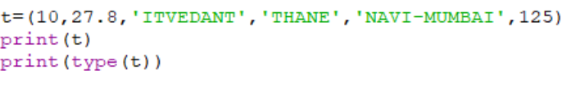

Slide 36
Allow Duplicates
Since tuples are indexed, they can have items with the same value:
Example
Tuples allow duplicate values:
thistuple = ("apple", "banana", "cherry", "apple", "cherry")
print(thistuple)

Slide 37
thistuple = ("apple",)
print(type(thistuple))
#NOT a tuple
thistuple = ("apple")
print(type(thistuple))

Slide 38
Indexing
Tuple has positive as well as Negative index
Indexing
Tuple has positive as well as Negative index
10 , 27.8 ,'ITVEDANT','THANE','NAVI-MUMBAI',125
0 1 2 3 4 5 -> positive Indexing
-6 -5 -4 -3 -2 -1 -> Negative Indexing

Slide 39


Slide 40
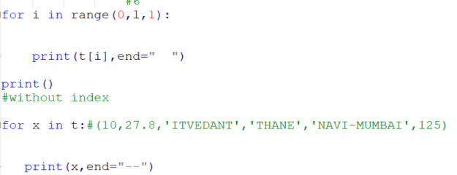

Slide 41
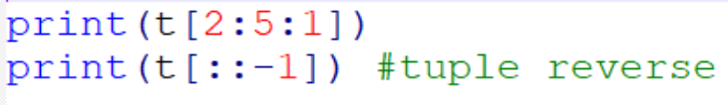
Tuple Slicing

Slide 42
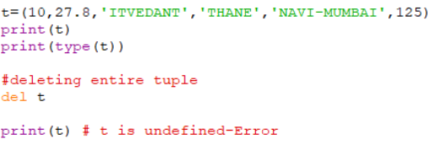
Modifying Tuple
Since Tuple is immutable we cannot add an element, update an element and delete a particular element from the tuple.
we can delete the entire Tuple with the help of del keyword.

Slide 43
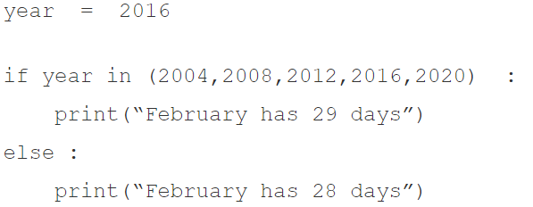
Membership Operator
in - checks if the value exist in a sequence
not in - checks if the value doesn’t exist in the sequence

Slide 44
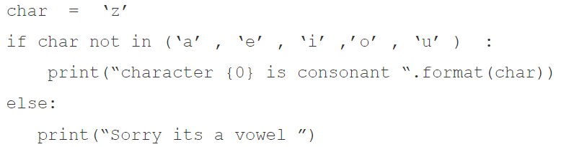

Slide 45
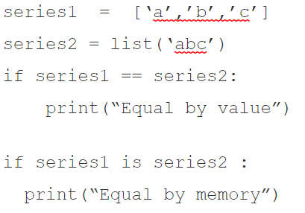
Identity Operator (Deep Equality)
is - checks if the value is equal by memory allocation reference
not is - checks if the value is unequal by memory allocation reference

Slide 46
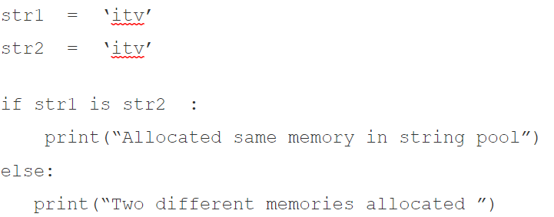

Slide 47
tuple() | Creates an empty tuple if no argument is passed. Creates a tuple if a sequence is passed as argument | >>> tuple1 = tuple() >>> tuple1( ) >>> tuple1 = tuple('aeiou')#string >>> tuple1('a', 'e', 'i', 'o', 'u') >>> tuple2 = tuple([1,2,3]) #list >>> tuple2(1, 2, 3) >>> tuple3 = tuple(range(5)) >>> tuple3(0, 1, 2, 3, 4)
count() | Returns the number of times the given element appears in the tuple | >>> tuple1 = (10,20,30,10,40,10,50) >>> tuple1.count(10) output: 3 >>> tuple1.count(90) output: 0
min() max() sum() | Returns minimum or smallest element of the tuple Returns maximum or largest element of the tuple Returns sum of the elements of the tuple | >>> tuple1 = (19,12,56,18,9,87,34) >>> min(tuple1) 9 >>> max(tuple1) 87 >>> sum(tuple1) 235

Slide 48
Set
A set is a list with unique elements.
A set is itself mutable however it can contain only immutable elements i.e elements which cannot be changed later (for hash purpose).
The location of the element in a set is unordered which means they are placed randomly at any position and hence cannot be indexed with [n] syntax.

Slide 49
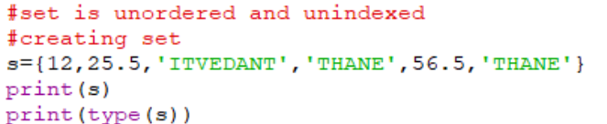
Set creation:
Set is unordered and unindexed.
To create a set use the curly brackets and place the elements separated by comma.

Slide 50
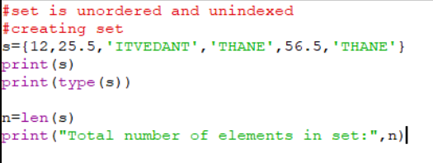
Number of elements in Sets
len(): This function is used to calculate the number of elements in the sets

Slide 51
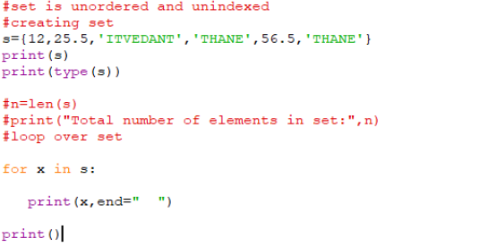
Loop Over Set:
Since set elements do not have indexes we cannot access the set element with the index in the for loop.

Slide 52
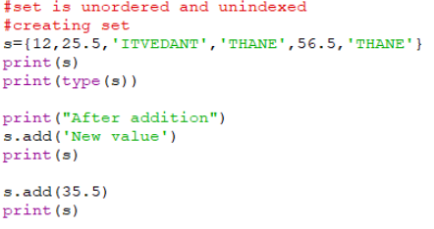
Add an element in set
add(): This function is used to add elements in the set.
set_object.add(value)

Slide 53
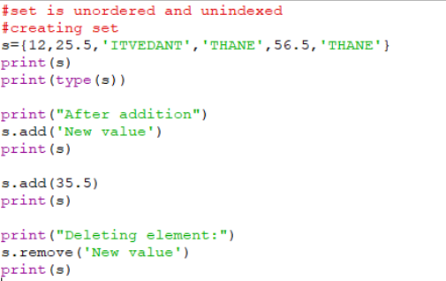
Remove element from sets
remove(): This function is used to remove elements from the set.
Syntax: set_object.remove(‘element_value’)

Slide 54
If the item to remove does not exist, remove() will raise an error but discard () wont through an error
thisset = {"apple", "banana", "cherry"}
thisset.discard("banana")
print(thisset)
You can also use the pop() method to remove an item, but this method will remove the last item. Remember that sets are unordered, so you will not know what item that gets removed.
The return value of the pop() method is the removed item.
Remove the last item by using the pop() method:
thisset = {"apple", "banana", "cherry"}
x = thisset.pop()
print(x)
print(thisset)

Slide 55
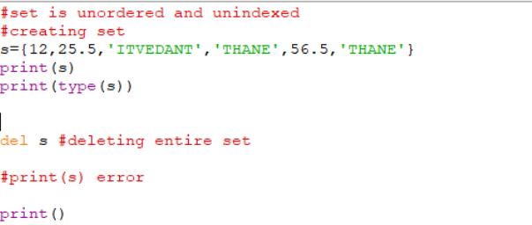
Deleting entire set
del keyword is used to delete entire set.
Syntax: del set_object
We get the above error as we are trying to print the set that is deleted.

Slide 56
Frozenset
These are like sets except that they cannot be changed, i.e. they are immutable.
A Frozenset() takes an iterable object as input and returns them as immutable. These sets are inbuilt functions of python which freezes the iterable objects and makes them immutable.

Slide 57
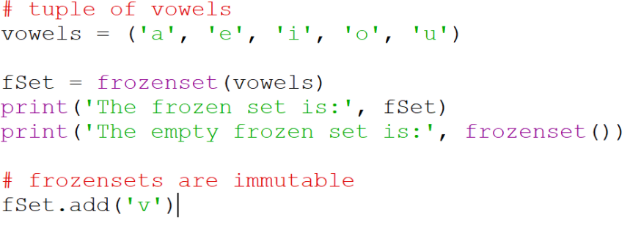
This will throw an error for fSer.add() saying no add method found.
Other operations that can be performed

Slide 58
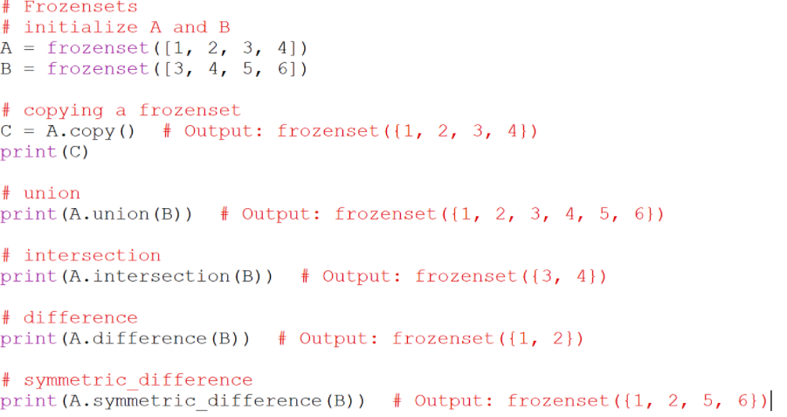

Slide 59
Dictionary
Python dictionary is a collection of key value pairs.
The keys of the dictionary are unique while the value may be duplicated.
If the key is known then its value can be easily retrieved.
Dictionary works like a list where the indexes are user defined.

Slide 60
Creating a dictionary
to create a dictionary use the curly brackets and place the key separated from the value with a colon.

Slide 61
#dict3 is the dictionary that maps names
#of the students to respective marks in
#percentage
>>> dict3 = {'Mohan':95,'Ram':89,'Suhel':92, 'Sangeeta':85}
>>> dict3{'Mohan': 95, 'Ram': 89, 'Suhel': 92, 'Sangeeta': 85}

Slide 62
Accessing Items in a Dictionary
>>> dict3 = {'Mohan':95,'Ram':89,'Suhel':92, 'Sangeeta':85}
>>> dict3['Ram’]
89
>>> dict3['Sangeeta’]
85
#the key does not exist
>>> dict3['Shyam’]
KeyError: 'Shyam'

Slide 63
Dictionaries are Mutable
Dictionaries are mutable which implies that the contents of the dictionary can be changed after it has been created
dict1 = {'Mohan':95,'Ram':89,'Suhel':92, 'Sangeeta':85}
>>> dict1['Meena'] = 78
>>> dict1 {'Mohan': 95, 'Ram': 89, 'Suhel': 92, 'Sangeeta': 85, 'Meena': 78}

Slide 64
Modifying an Existing Item
The existing dictionary can be modified by just overwriting the key-value pair
>>> dict1 = {'Mohan':95,'Ram':89,'Suhel':92, 'Sangeeta':85}
#Marks of Suhel changed to 93.5
>>> dict1['Suhel'] = 93.5
>>> dict1{'Mohan': 95, 'Ram': 89, 'Suhel': 93.5,
'Sangeeta': 85}

Slide 65
The values in dictionary items can be of any data type:
Example
String, int, boolean, and list data types:
thisdict = {
"brand": "Ford",
"electric": False,
"year": 1964,
"colors": ["red", "white", "blue"]
}

Slide 66
Get Keys
The keys() method will return a list of all the keys in the dictionary.
Example
Get a list of the keys:
x = thisdict.keys()
Get Values
The values() method will return a list of all the values in the dictionary.
Example
Get a list of the values:
x = thisdict.values()

Slide 67
Get Items
The items() method will return each item in a dictionary, as tuples in a list.
Example
Get a list of the key:value pairs
x = thisdict.items()

Slide 68
Update Dictionary
The update() method will update the dictionary with the items from the given argument.
The argument must be a dictionary, or an iterable object with key:value pairs.
Example
Update the "year" of the car by using the update() method:
thisdict = {
"brand": "Ford",
"model": "Mustang",
"year": 1964
}
thisdict.update({"year": 2020})

Slide 69
Loop Through a Dictionary
You can loop through a dictionary by using a for loop.
Print all key names in the dictionary, one by one:
for x in thisdict:
print(x)
Print all values in the dictionary, one by one:
for x in thisdict:
print(thisdict[x])
You can also use the values() method to return values of a dictionary:
for x in thisdict.values():
print(x)
You can use the keys() method to return the keys of a dictionary:
for x in thisdict.keys():
print(x)
Loop through both keys and values, by using the items() method:
for x, y in thisdict.items():
print(x, y)

Slide 70
Nested Dictionaries
A dictionary can contain dictionaries, this is called nested dictionaries.
Create a dictionary that contain three dictionaries:
child1 = {
"name" : "Emil",
"year" : 2004
}
child2 = {
"name" : "Tobias",
"year" : 2007
}
child3 = {
"name" : "Linus",
"year" : 2011
}
myfamily = {
"child1" : child1,
"child2" : child2,
"child3" : child3
}
Try it Yourself »

Slide 71
Membership
>>> dict1 = {'Mohan':95,'Ram':89,'Suhel':92, 'Sangeeta':85}
>>> 'Suhel' in dict1
True
>>> dict1 = {'Mohan':95,'Ram':89,'Suhel':92, 'Sangeeta':85}
>>> 'Suhel' not in dict1
False

Slide 72
>>> dict1 ={'Mohan':95,'Ram':89,'Suhel':92, 'Sangeeta’:85}
method1
>>> for key in dict1:
print(key,':',dict1[key])
Mohan: 95
Ram: 89
Suhel: 92
Sangeeta: 85
method2
>>> for key, value in dict1.items():
print(key , ':’, value)

Slide 73
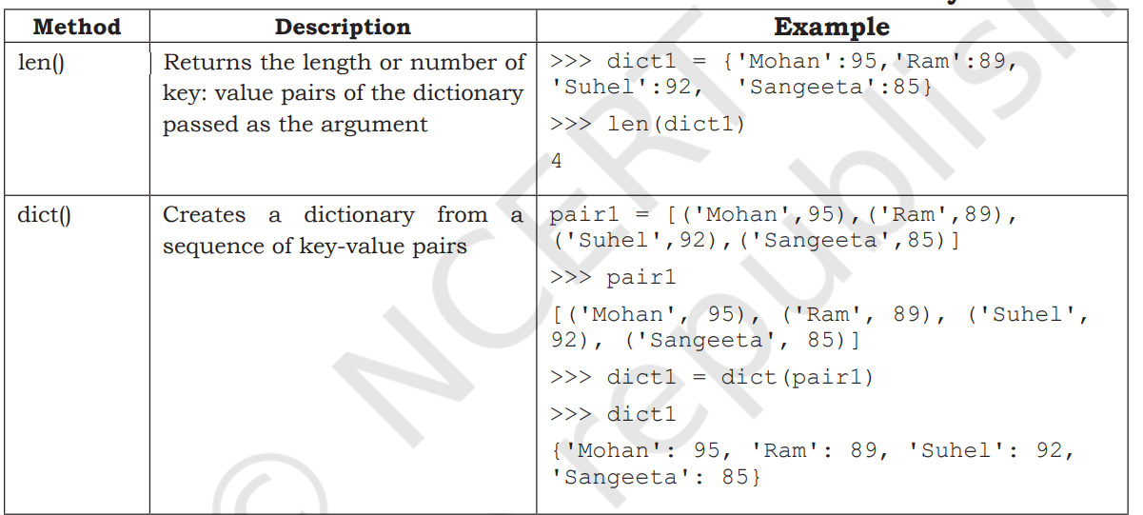

Slide 74
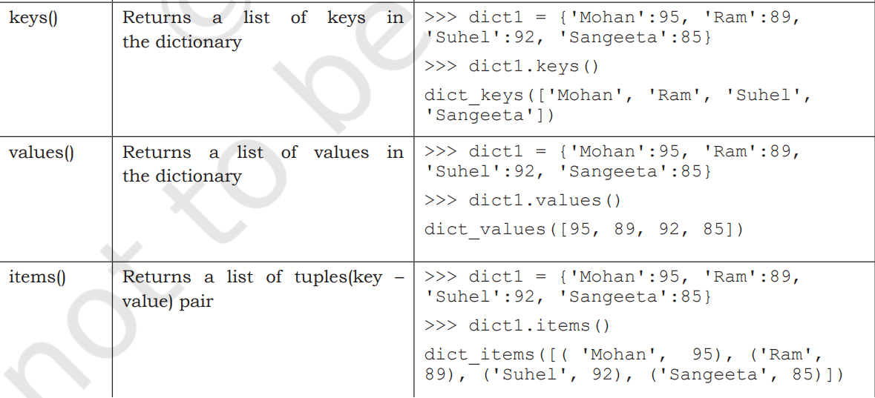

Slide 75
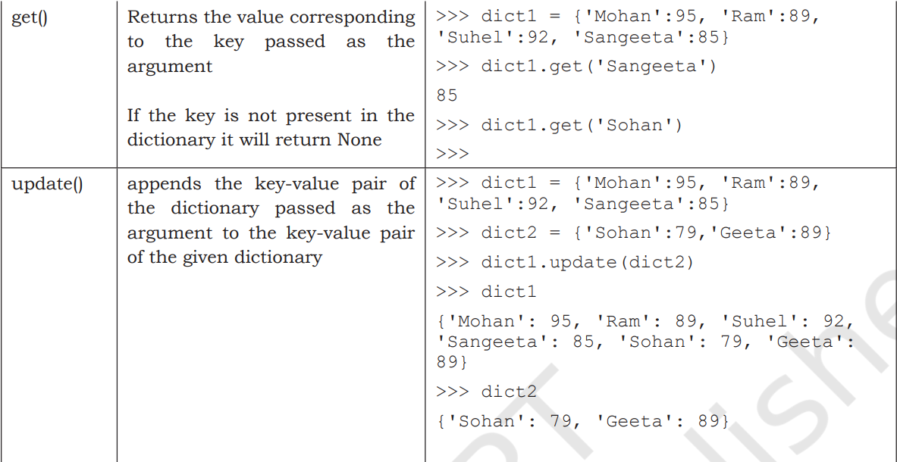

Slide 76
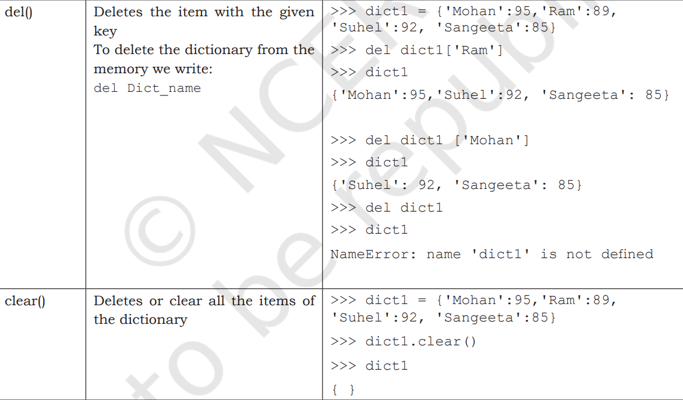

Slide 77
Accessing the elements of the dictionary
To access the elements of the dictionary use the index or retrieve the element using the get() method.
Adding and Updating the elements of the dictionary
To add or update the elements of the dictionary use the index.

Slide 78
Removing the elements of the dictionary
To remove the elements of the dictionary use the index.
Retrieving Keys and Values
We can retrieve a collection of keys / values from the dictionary using the key() and the values() method.

Slide 79
Create a dictionary ‘ODD’ of odd numbers between 1 and
10, where the key is the decimal number and the value is the
corresponding number in words. Perform the following operations
on this dictionary:
(a) Display the keys
(b) Display the values
(c) Display the items
(d) Find the length of the dictionary
(e) Check if 7 is present or not
(f) Check if 2 is present or not
(g) Retrieve the value corresponding to the key 9
(h) Delete the item from the dictionary corresponding to the key 9
Sort the list of tuples by its second element.
Create a Dictionary having child Dictionary. Display all the elements of child Dictionary.

Slide 80
4..Join items of given list using "and" and print the string
#weekdays = ['sun','mon','tue','wed','thu','fri','sat']
#Output: 'sun and mon and tue and ....'
5.Write the program to accept the value in string and concatenate the two string and multiply the string by 10 and print the output on interpreter.
6. Given String - "Hello world"
Count the appearance of each alphabet and store in a dictionary.
Expected result - {"H":1, "e":1,"l":3,"o":2,"w":1,"r":1,"d":1}
7. Given a string s1="Itvedant Chennai", s2="training"
1.use slice operator in string S1 and display
chennai
ant
vedant
ivdn
cni
2.find length of s1 and display.
3.Display character in string s1 one by one.
4 Combine s1,s2 in new string s3 and display.
5.Replace itvedant chennai to itvedant pune.
6. Replace the space( ) in s3 with colon(:)
7.Split s3 use separator as ':'

